Slide 1
New Trustee Orientation

Slide 2
Our Mission
The mission of the Arkell Museum at Canajoharie and the Canajoharie Library is to promote and celebrate the understanding and enjoyment of the arts and humanities in Canajoharie, the Mohawk Valley, and beyond.
Notes:
Diane

Slide 3
Who Are We?
A Library with a museum?
A Museum with a community library?

Slide 4
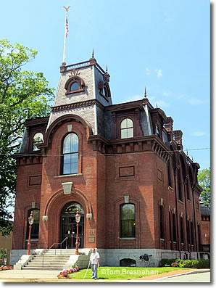
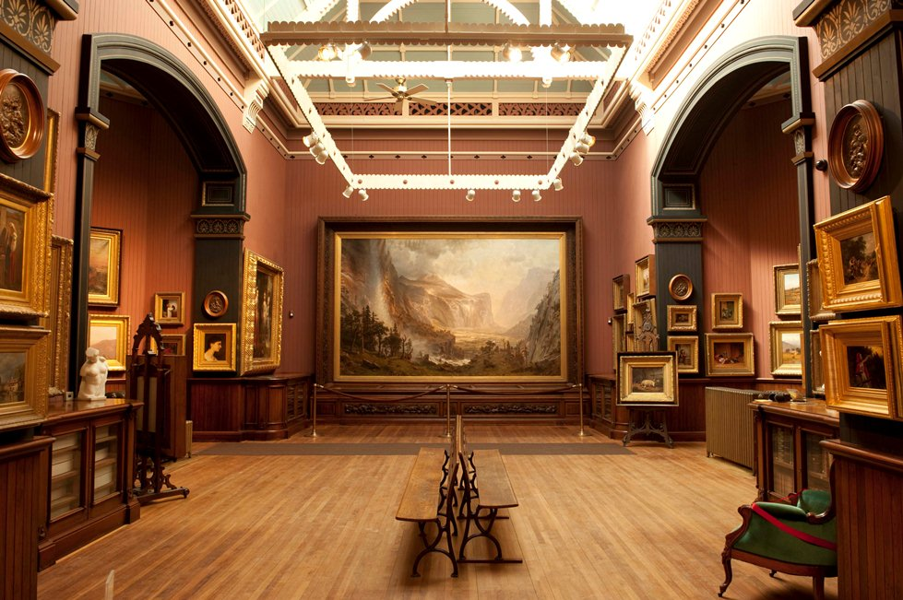
Long Tradition of Library with Art Collections and Galleries in America but very few survive.
St Johnsbury Athenaeum, Vermont, founded 1871

Slide 5
Public Libraries in NYS
Board of Regents | Commissioner of Education |
Deputy Commissioner of Cultural Education
|
Division of Library Development (DLD)
Public Library Systems (23) -Public Libraries -Association Libraries -Correctional Facility Libraries

Slide 6
Mohawk Valley Library System
Connects 23 libraries through a shared library catalog
Weekday delivery to all member libraries or requested materials
Professional Consulting
Continuing Education & Training
Grant Writing
Coordination
JA
Notes:
Public Library systems were created to:
Encourage libraries to share their resources with other libraries;
Provide a source for professional expertise and advice for public libraries regardless of their size, staffing and budget
To create a opportunities for economies of scale through shared purchasing and contracts for services. Funding for Public Library Systems comes largely from NYS. The Library Aid part of the State Budget goes to fund the operation of systems.

Slide 7
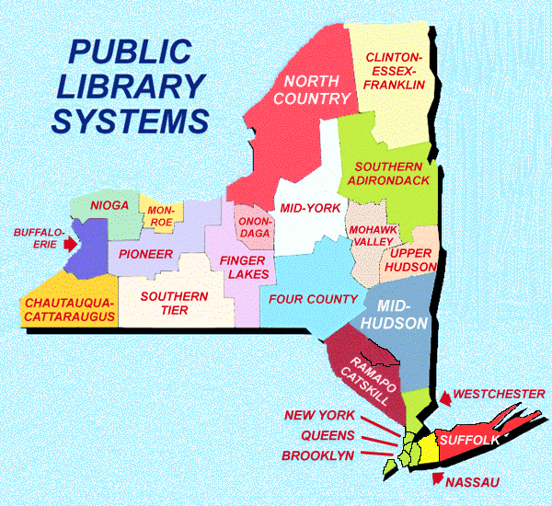

Slide 8
Minimum Standards to
be a NYS Public Library

Slide 9
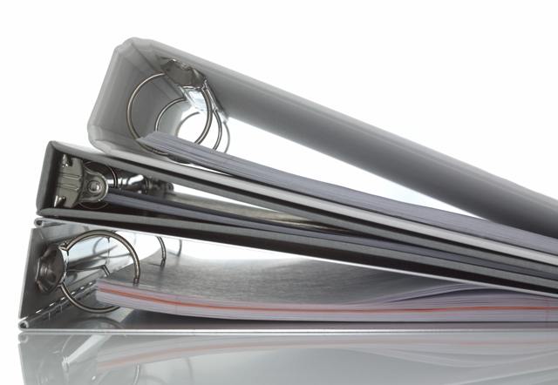
#1 Written By-Laws

Slide 10
#2 Board Approved
Written Long Range
Plan of Service

Slide 11
#3 Annual Report
to the Community

Slide 12
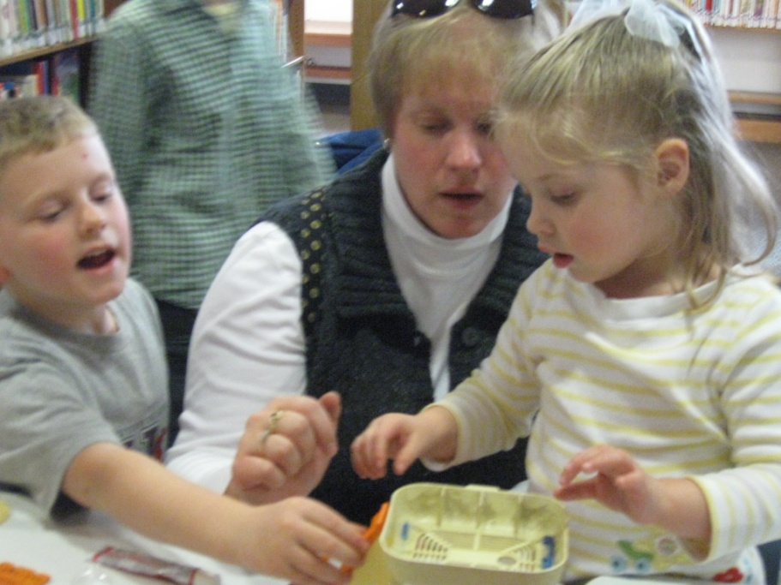
#4 Board Approved
Written Policies
of Operation

Slide 13
#5 Annual Budget
Presented to Funding
Agencies

Slide 14
#7 Maintains Minimum
Open Hours

Slide 15
Service Population Minimum Weekly Hours Open
Up to 500 12
500-2,499 20
2,500-4,999 25
5,000-14,999 35
15,000-24,999 40
25,000-99,999 55
100,000 and above 60
Our Winter Hours: 32 | Our Regular Hours: 40
#5 Annual Budget
Presented to Funding
Agencies

Slide 16
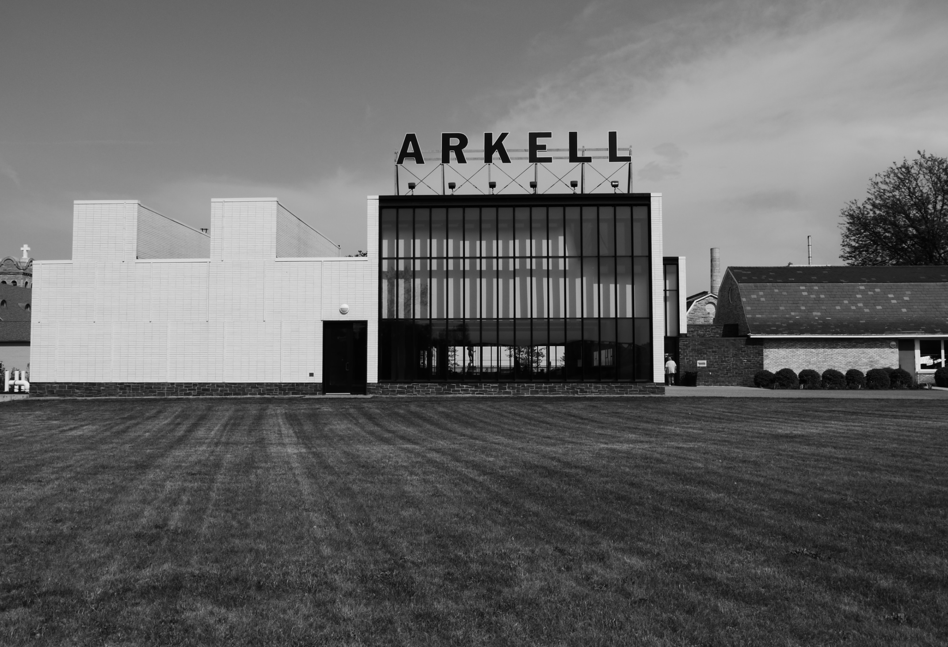
#8 Maintains Adequate
Facility to Meet Community
Needs

Slide 17
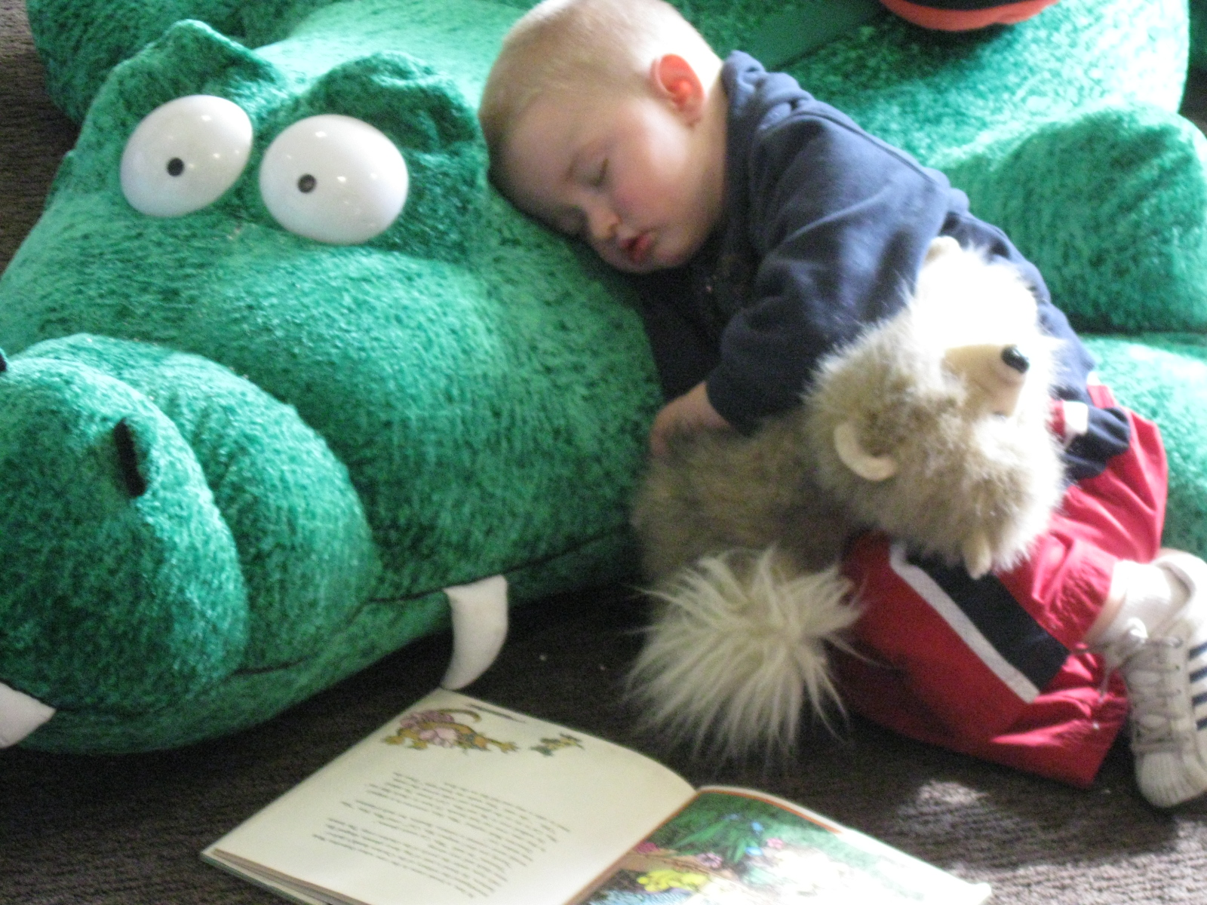
#9 Provides Equipment & Connections to Meet Community Needs

Slide 18
#10 Distributes Printed
Information About the
Library

Slide 19
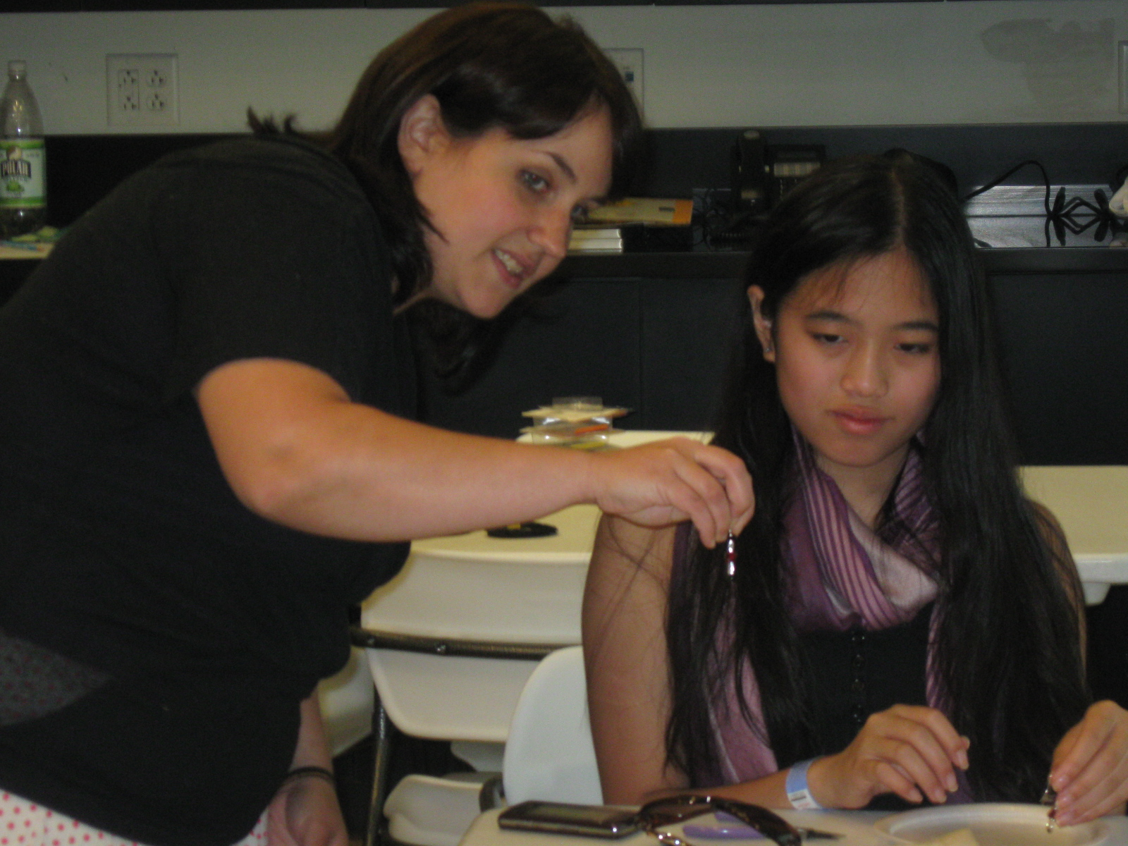
#11 Employs a
Paid Director

Slide 20
Library Director Minimum Qualifications
Service Population Education requirement*
2,500-4,999 2 years of college study
5,000-7,499 Bachelor’s degree
7,500 + MLS or equivalent and public librarian’s certificate
* If the library is a member of a public library system

Slide 21
Open Meeting Law
All public libraries in NYS must post and advertise to the public that their
Board meetings are open to the public.
All committees and sub-commitees of the Board if they are comprised mostly of Board members must also comply with this law.
Executive sessions are exempt as long as any of the following purposes are discussed
Discussion regarding proposed, pending, or current litigation
Collective bargaining negotiations (civil service)
Medical, financial, credit, or employment history of a person or corporation.
Also matters leading to the appointment, employment, promotion,
demotion, discipline, suspension, dismissal or removal of a person
The proposed acquisition, sale or lease of real property or sale or exchange
of securities only when publicity would substantially affect the value thereof.
Minutes of board meetings are required to be accessible to the public upon request.
Minutes of executive sessions are required only if the board took formal action during
The session.

Slide 22
Essential Duties of Trustees
of the Canajoharie Library
and Arkell Museum
Notes:
Chuck:

Slide 23
Review mission statements of the library
& museum on an annual basis
Notes:
Chuck:

Slide 24
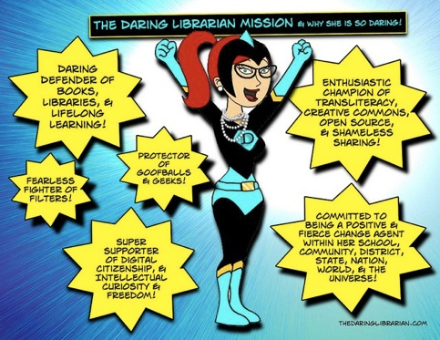
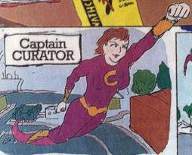
Select, hire, & regularly evaluate qualified directors
Notes:
Chuck:

Slide 25
Secure adequate funding
for the library & museum
Notes:
Chuck:

Slide 26
Exercise fiduciary responsibility
Notes:
Chuck:

Slide 27
Adopt policies for the governance &
use of the library & museum
Notes:
Chuck:

Slide 28
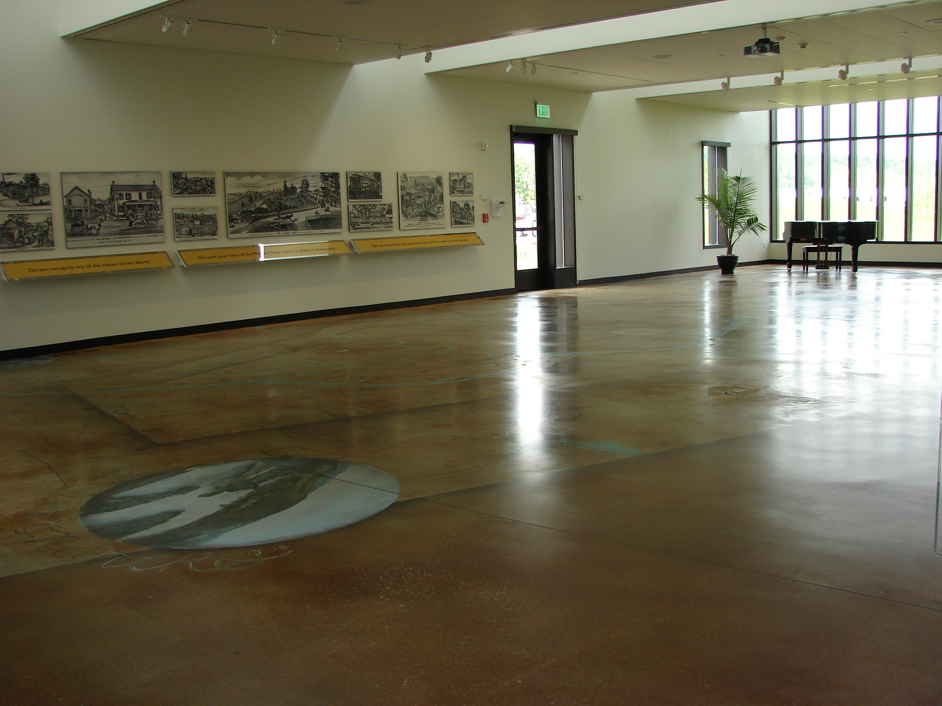
Work with directors to maintain a facility
to meet the community & organization’s
needs
Notes:
Chuck:

Slide 29
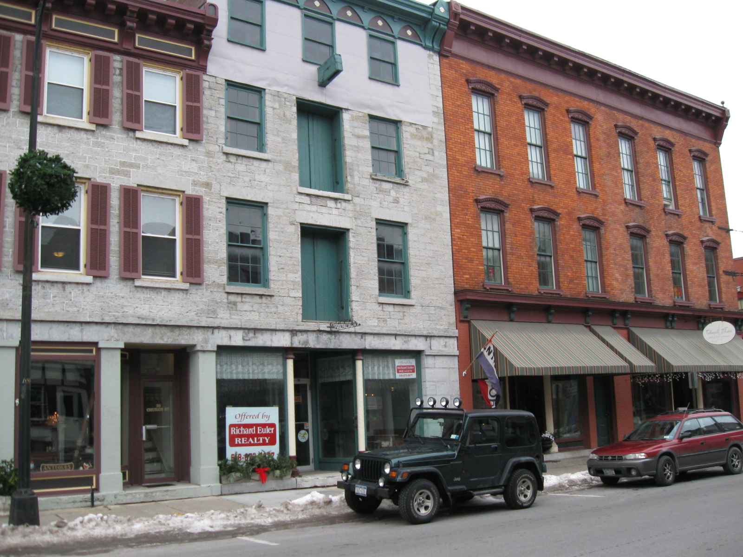
Promote the organization
in the local community &
society in general

Slide 30
Conduct business in an open & ethical manner

Slide 31
Regularly work with the directors to develop and evaluate strategic and long-range plans .
Strategies
Goals
Objectives
Resources
Notes:
Diane:
Need to develop a new 5 year plan for both library and museum. This plan will be used to establish the annual budget and fundraise for the future.

Slide 32
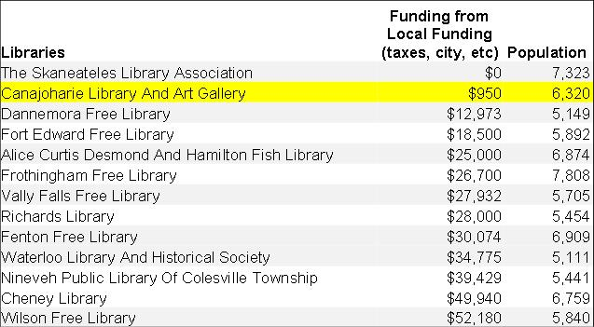
Library Vote
Notes:
Tried in 2012 but failed by a 2 to 1 margin. We are the second least publically funded library within our population range in NYS.

Slide 33
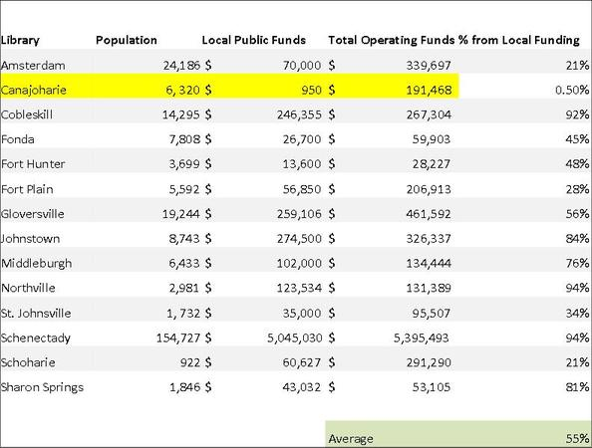
Notes:
Circulation is increasing and funding is going down. If we had tax payer support we would be able to go to voters for that percentage increase every few years.

Slide 34
Vote in 2014
Small board committee to set dates, and identify and
mold the campaign. All board members will be working
To get the vote out to our supporters.

Slide 35
2013 Budget
Expenses (2013 budget $503, 870):
Salaries & Benefits: $247,680
Audit and tax prep: $7,250
Building and Grounds: $33,500
Library books/Av/ Periodicals/other: $7,300
Library supplies and equipment :$2,000 Library Programs: $2,900
Library Joint Automation contract fees: $7,777
Museum collections care: $7,400
Museum exhibitions & programs: $18,800 Federal Excise Tax: $1,500
Office supplies & equipment: $15,000 Trustees & Committees: $600
Insurance: $45,400
Telephone & Communications : $4,200 Utilities : $74,000
Membership & Fund-Raising : $6,000 Museum marketing : $15,000
Institutional Memberships & Fees : $1,213
Travel & Professional Development : $1,400 Gift Shop: $3,800
Community Gallery : $1,150 Postage
Funding Sources (2013 budget: $503, 875):
Arkell Hall Foundation: $100,000
NYSCA Grants: $14,000
MVLS Grants: $2,500
Membership: $28,000
Annual Appeal: $40,000
Sponsorships & Foundation Grants: $21, 500
Summer Library Programs: $2,150
Adopt a Magazine/Book: $1,175
Used Book Sales: $2,500
Library Fees & Fines: $3,500
Rentals: $10,400
Gift Shop: $10,000
Juried Art Show: $2,300
Admission: $20,000
Program Fees: $800
Fundraisers: $11,000
R & R Loan Fees: $2,100
Local Taxpayer Support: $700
Withdrawal from Endowment Investments: $231, 250

